Slide 1
Beyond Prefixes: The Power of Routing Policies and IRRs
Milad Afshari | CAPIF4 | Almaty, September 2025

Slide 2

Who am I?
Milad Afshari
Enterprise Network Planning Manager @ MTN-Irancell(AS44244)
Co-founder & PC chair of IRNOG
PC member of CAPIF
Notes:
اشاره به اینکه سال گذشته در مورد روتینگ سکوریتی ئر منطقه صحبت کردم. امسال تصمیم گرفتم با توجه به اینکه بهبود وضعیت امنیت روتینگ در آسیای مرکزی هنوز جا داره بهتر بشه بخصوص قزاقستان که درصد روآ ساین شده خیلی کمی داره، مجدد کمی پایه ای تر از اهمیت این موضوع صحبت کنم.

Slide 3
Why This Talk?
Last year I spoke about routing security in the region. This year, since there is still room for improvement in Central Asia — including Kazakhstan — I decided to revisit the basics and highlight again why this topics matters:
BGP has no built-in security mechanisms
Misconfigurations and hijacks still happen
Routing policies and IRRs help us bring order
Goal: strengthen Internet resilience & security

Slide 4
BGP at a Glance: Strengths and Challenges

Slide 5
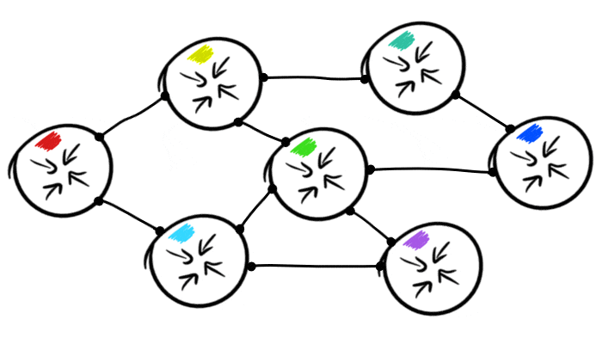
Internet Number Resources & BGP
The Internet relies on identifiers:
IPv4 Addresses
IPv6 Addresses
Autonomous System Numbers (ASNs)
BGP:
For nearly 30 years BGP has kept the Internet running, but it still faces security challenges. It was originally designed when the Internet was much smaller and based on a trust model between network operators

Slide 6
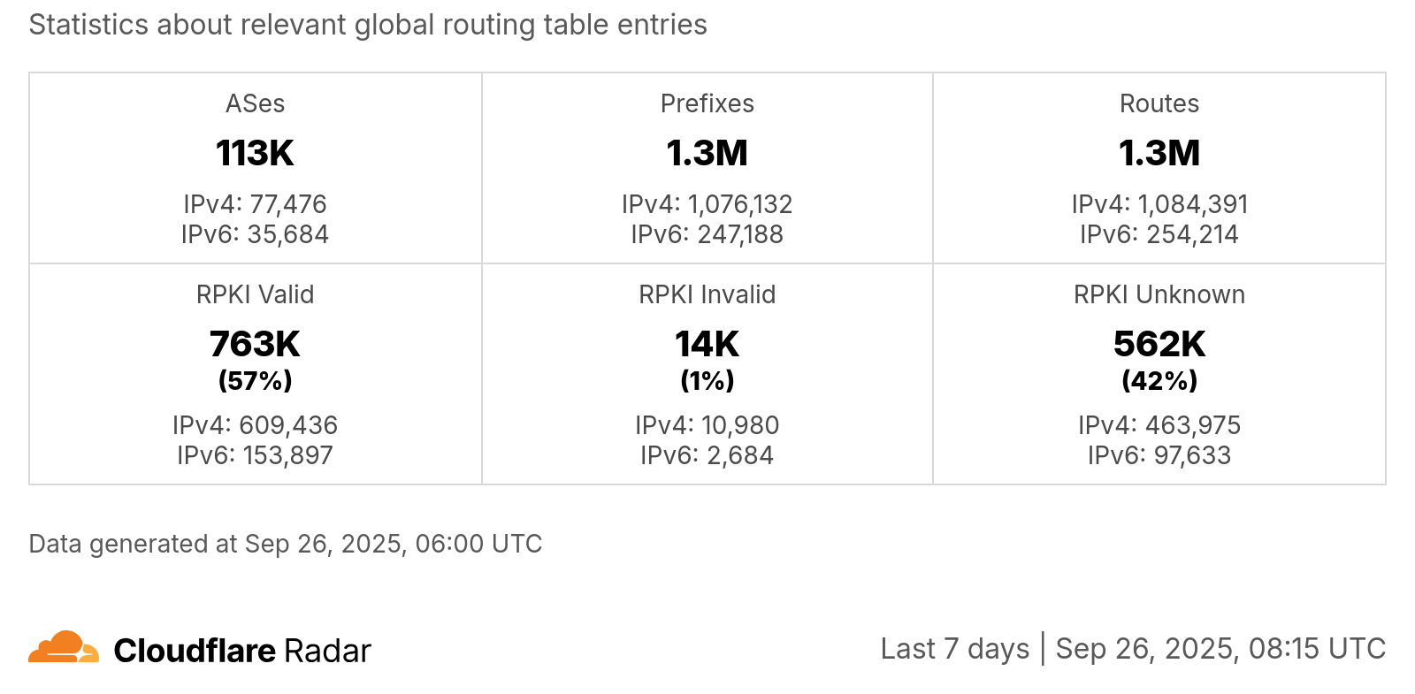
BGP Routing Statistics

Slide 7
The Problem with BGP
Prefix Hijacking: redirect traffic
Route Leaks: instability & misrouting
Misconfigurations: global outages
No built-in verification
Event | Explanation | Repercussions
Prefix/Route Hijacking | A network operator or attacker impersonates another network operator, pretending that a server or network is their client. | Packets are forwarded to the wrong place; this can cause Denial of Service (DoS) attacks or traffic interception.
Route Leak | A network operator with multiple upstream providers announces (often due to accidental misconfiguration) to one upstream provider that is has a route to a destination through the other upstream provider. | Can be used for traffic inspection and reconnaissance.

Slide 8
BGP Incidents Overview
1997
2008
2013
2018
2024
AS7007 Incident
Pakistan Telecom and YouTube
Belarus BGP MITM Attack
MyEtherWallet Attack
1.1.1.1
Route Leak
Event: Software bug led to a large part of IP address ranges being misannounced as originating from AS7007.
Impact: Traffic was redirected and overwhelmed AS7007’s equipment, causing widespread disruption.
Event: Pakistan Telecom attempted to block YouTube locally but accidentally propagated the block globally.
Impact: Global internet access to YouTube was disrupted.
Event: BGP-based man-in-the-middle attack targeting major US credit card companies and governments.
Impact: Interception of sensitive communications.
Event: BGP hijacking led to DNS redirection and phishing of cryptocurrency wallets.
Impact: $17 million stolen from users due to compromised TLS connections.
Event: The issue started on June 27, when Eletronet S.A. (AS267613) mistakenly announced a very specific route (1.1.1.1/32) to its peers and upstream providers.
Impact: The incident impacted around 300 networks across 70 countries, though Cloudflare noted that the overall impact was relatively low and many users did not notice significant disruption.

Slide 9
IRR (Internet Routing Registry)

Slide 10
Internet Routing Registry (IRR)
IRR - the Internet Routing Registry
Public routing policy databases
Used to register routing information
Declaration of BGP announcements, connected peers and routing policies
Many IRR databases exist
Mostly mirroring each other
RIPE, APNIC, RADB, JPIRR, Level3, NTTCom, etc.
https://irr.net/

Slide 11

Why register routing information?
Document your routing policy
Associate network prefixes with an origin AS
Helps to filter unauthorized announcements
Mitigates route hijacks and denial of service
Many transit providers and IXPs require it
They build their filters based on the Routing Registry

Slide 12
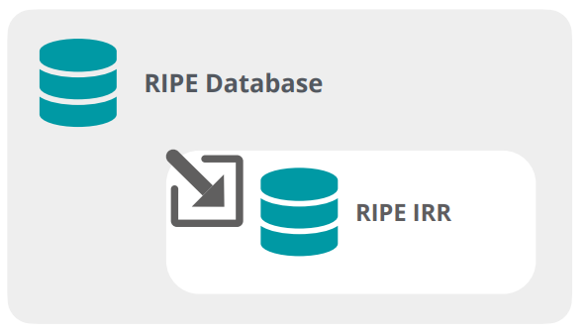
The RIPE Routing Registry
The RIPE IRR is a subset of the RIPE Database
Used for registering routing policy information
Includes several objects
route(6), aut-num, filter-set, route-set, …
The RIPE Routing Registry is a part of the global IRR system

Slide 13
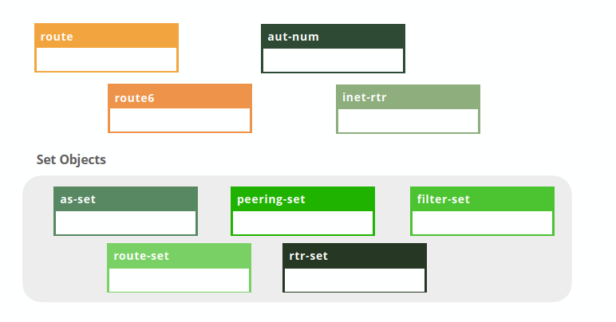
IRR Objects
route / route6: prefixes
aut-num: AS & policies

Slide 14
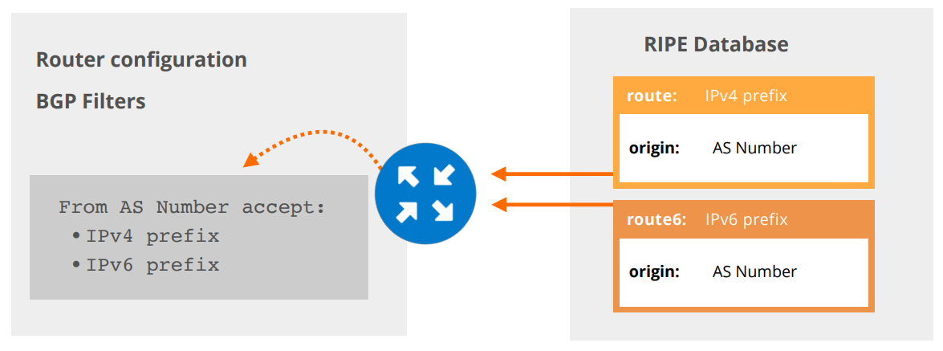
route(6) objects
Contains routing information for IPv4/IPv6 address space
Specifies from which AS a certain prefix may be originated
Used for creating BGP filters

Slide 15
BGP Routing Policy

Slide 16
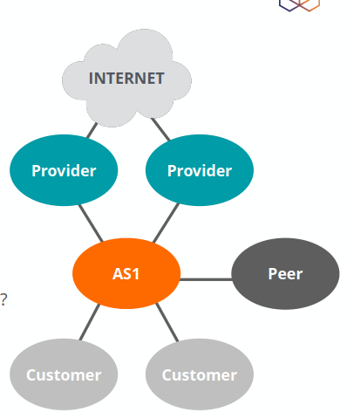
What is a Routing Policy?
Who are your BGP peers? Which ASes?
What is your BGP relationship with them?
Customer, Provider, Peer
What are your routing decisions?
Which prefixes to accept?
Which prefixes to announce?
Which prefixes will be preferred in case of multiple routes?

Slide 17
RPSL Language
RPSL - Routing Policy Specification Language
Allows network operators to specify their routing policies
Generic way to describe BGP configuration in the IRR
Not vendor-specific
Originated from a RIPE Document (RIPE-181)
Can be translated into router configuration
RFC 2622 - Routing Policy Specification Language RFC 2650 - Using RPSL in Practice

Slide 18
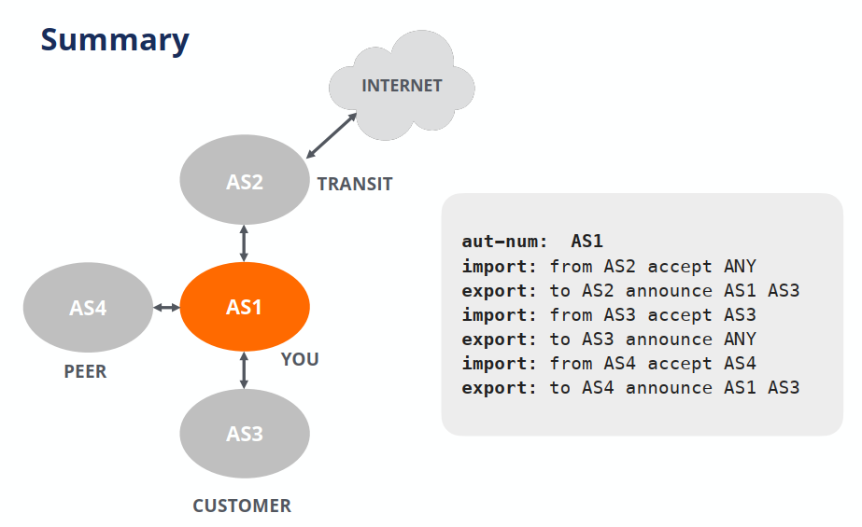
Routing Policies in Practice
Notes:
- With Providers: announce only customer routes
- With Customers: accept their prefixes
- With Peers: exchange only customer routes

Slide 19
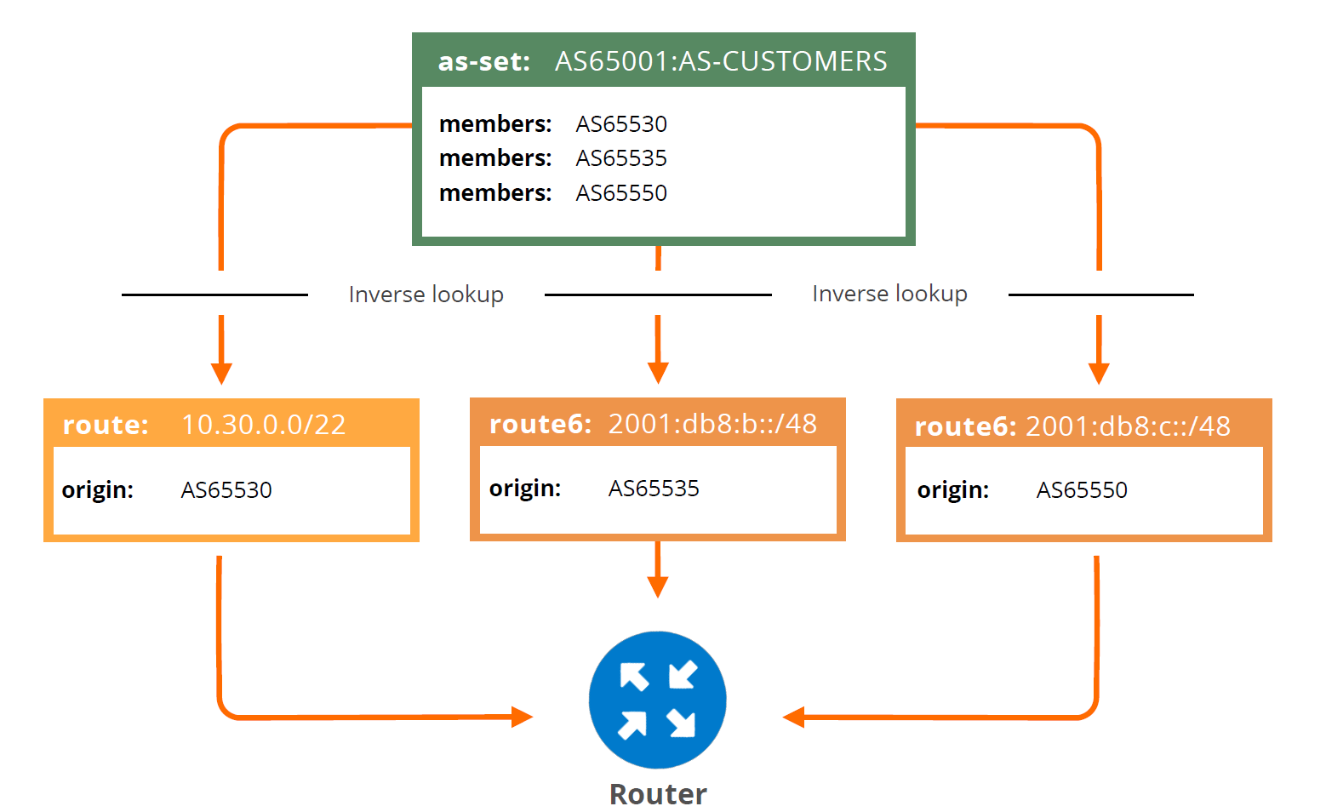
IRRs & BGP Automation
Tools available that get the policy data from the IRRs
Extract prefixes from route(6) objects
Query the IRRs over Whois protocol
Some can generate complete router configurations
Most are open source tools
Generating a Prefix Filter:

Slide 20
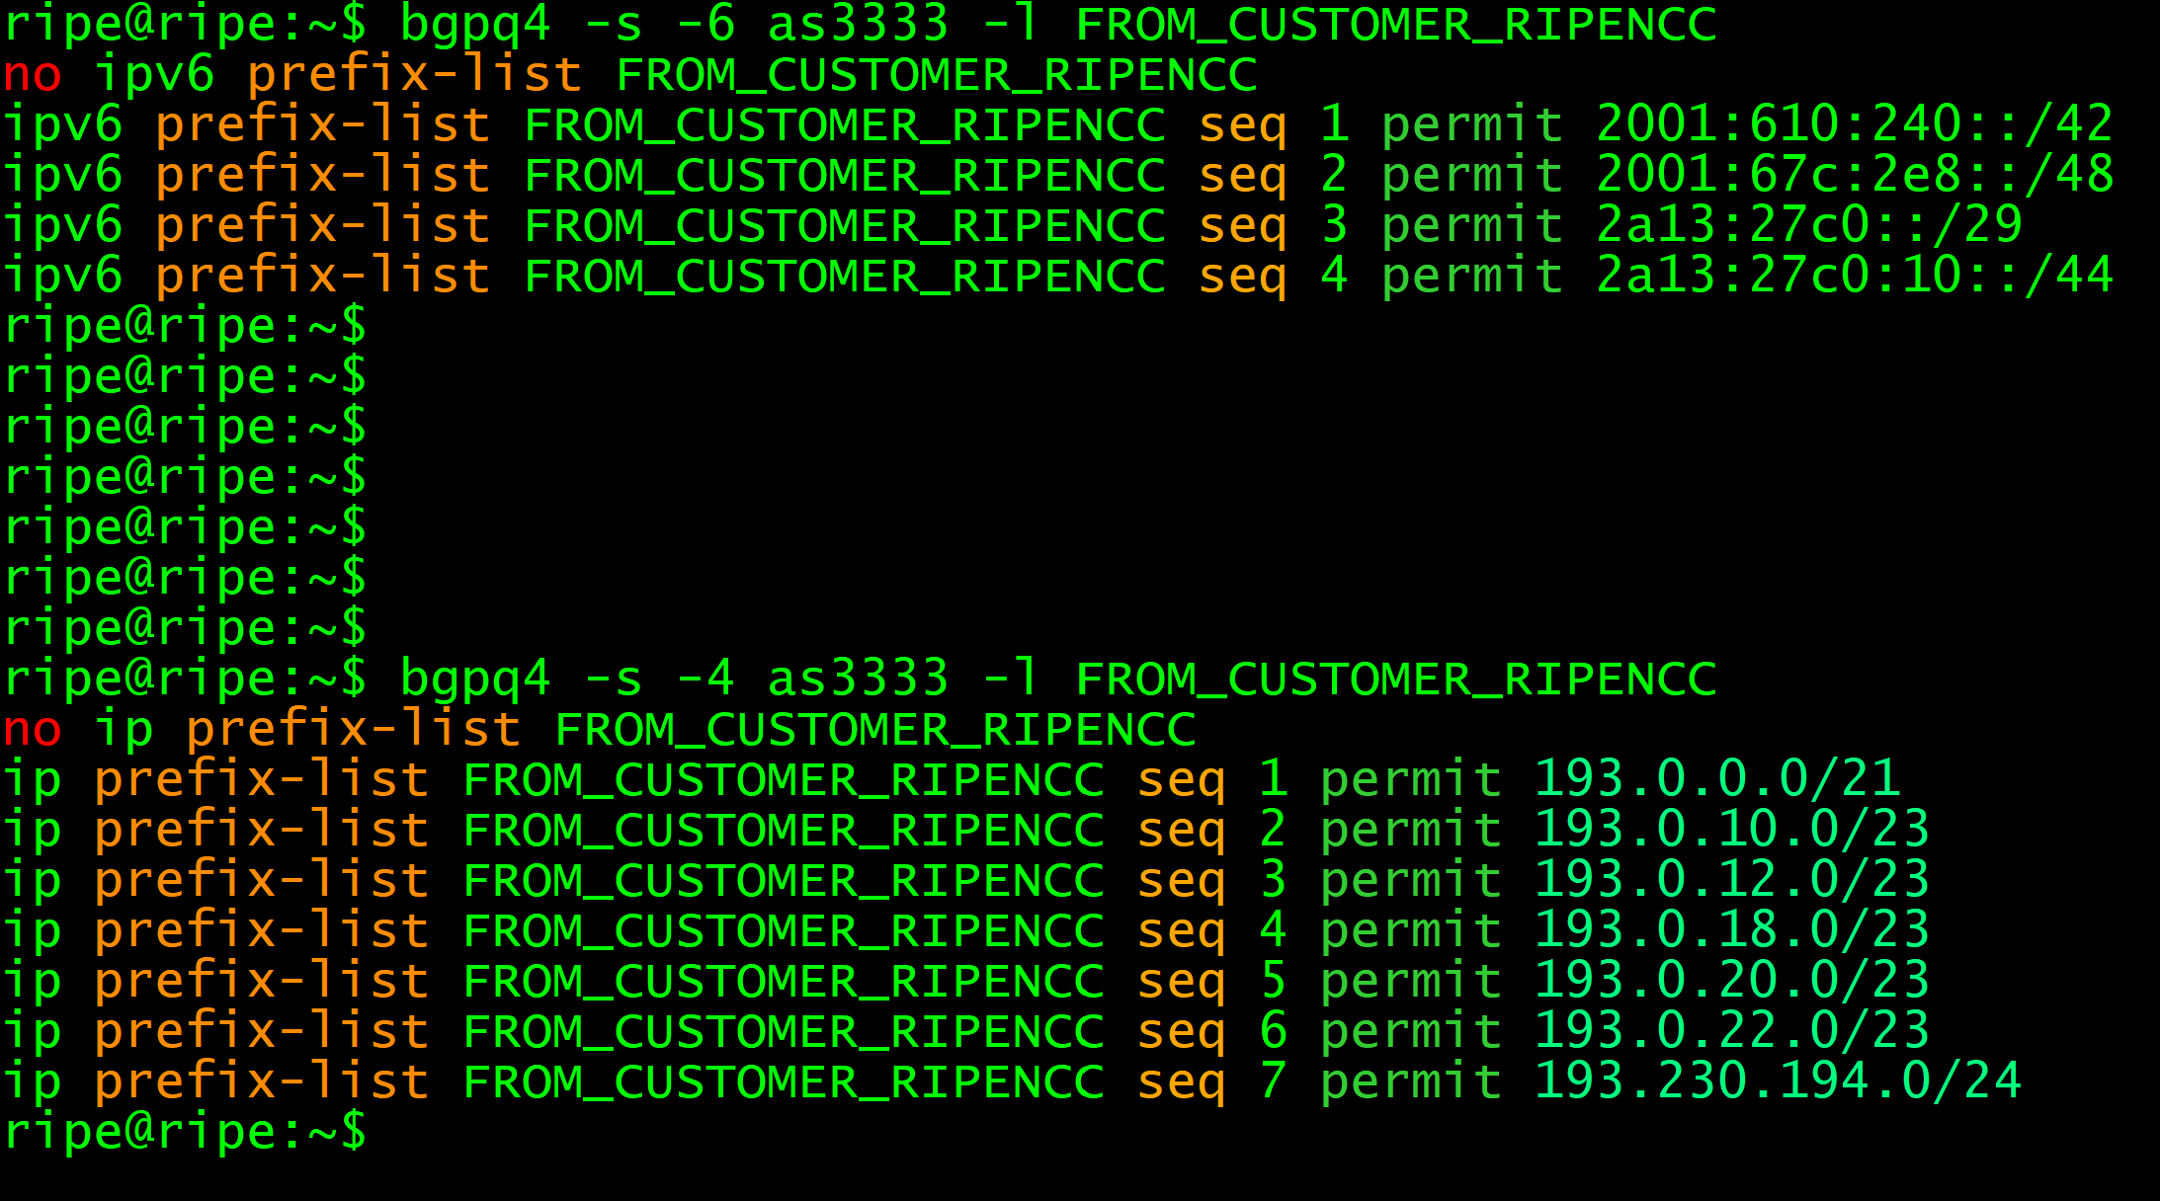
RPSL tools for BGP automation
IRRToolset (written in C++)
https://github.com/irrtoolset/irrtoolset
Rpsltool (perl)
https://github.com/rfc1036/rpsltool
IRR Power Tools (PHP)
https://github.com/6connect/irrpt
bgpq4 (C)
https://github.com/bgp/bgpq4
Filtergen (Level 3)
- https://github.com/anchor/filtergen
- whois -h filtergen.level3.net RIPE::ASxxx
bgpq4 example

Slide 21

IRR Limitations
IRRs may contain conflicting data
Distributed databases that mirror each other
No central authority
Who will verify the accuracy of the data?
No verification of holdership
In some IRRs, you can create objects without checks
Not updated properly
Information is missing, outdated or incorrect
Notes:
43 IRR filters are good only if the IRR entries are correct!

Slide 22
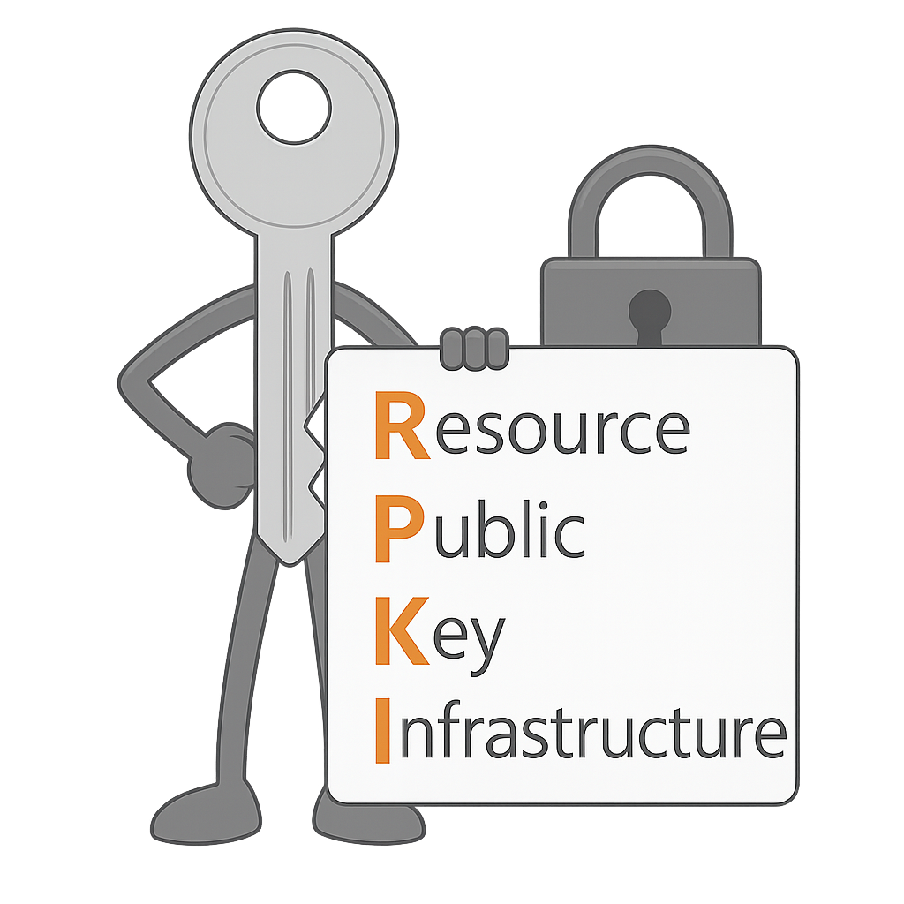
RPKI
Verifies the association between resource holders and their Internet number resources
Attaches digital certificate to IP addresses and AS numbers
RPKI is based on an X.509 certificate profile defined in RFC3779.
Only ~50% of IPv4 covered by RPKI
IRR still critical for remaining space
Dual use = best security today

Slide 23
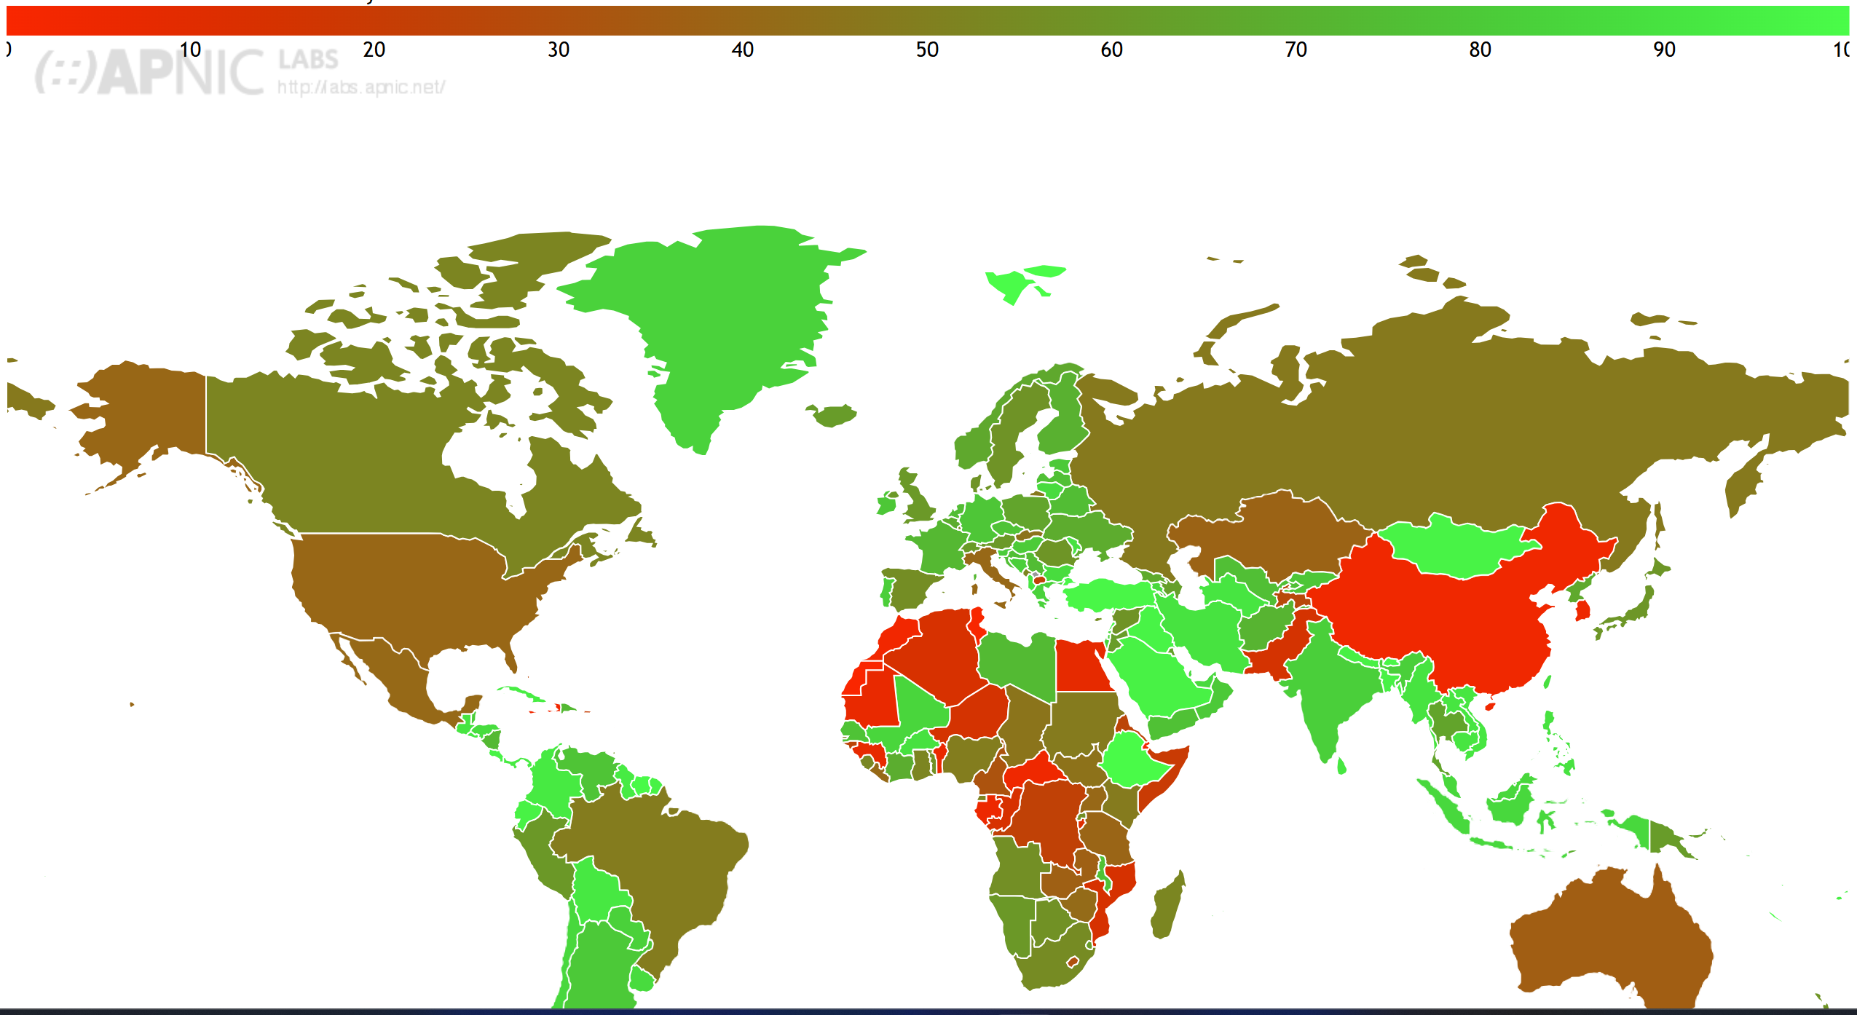
ROA data by Country (%)

Slide 24
Conclusion
RPKI (ROA/ROV) is the most effective defense against accidental BGP hijacks and origin leaks. Steps for success:
Creation of ROAs (Route Origin Authorizations).
ASes (Autonomous Systems) rejecting routes inconsistent with ROAs.
The most effective security approach today is the combined use of IRR and RPKI
IRR provides broad, policy-based filtering and operational transparency
RPKI adds cryptographic validation of prefix ownership where available
This dual strategy ensures wider coverage, stronger accuracy, and better protection against routing threats
Together, they significantly enhance the resilience and security of the global Internet

Slide 25
References
https://ripe.net
https://academy.ripe.net
https://iana.org
https://irr.net
https://www.kentik.com/blog/a-brief-history-of-the-internets-biggest-bgp-incidents
https://academy.ripe.net
https://stat.ripe.net
https://labs.apnic.net/measurements

Slide 26
Thank you! Any Questions?
سپاسگزارم!
سوالی هست؟
Спасибо! Есть вопросы?

